Slide 1

ZOMATO DATA ANALYSIS
-Aayushi Vashishth

Slide 2
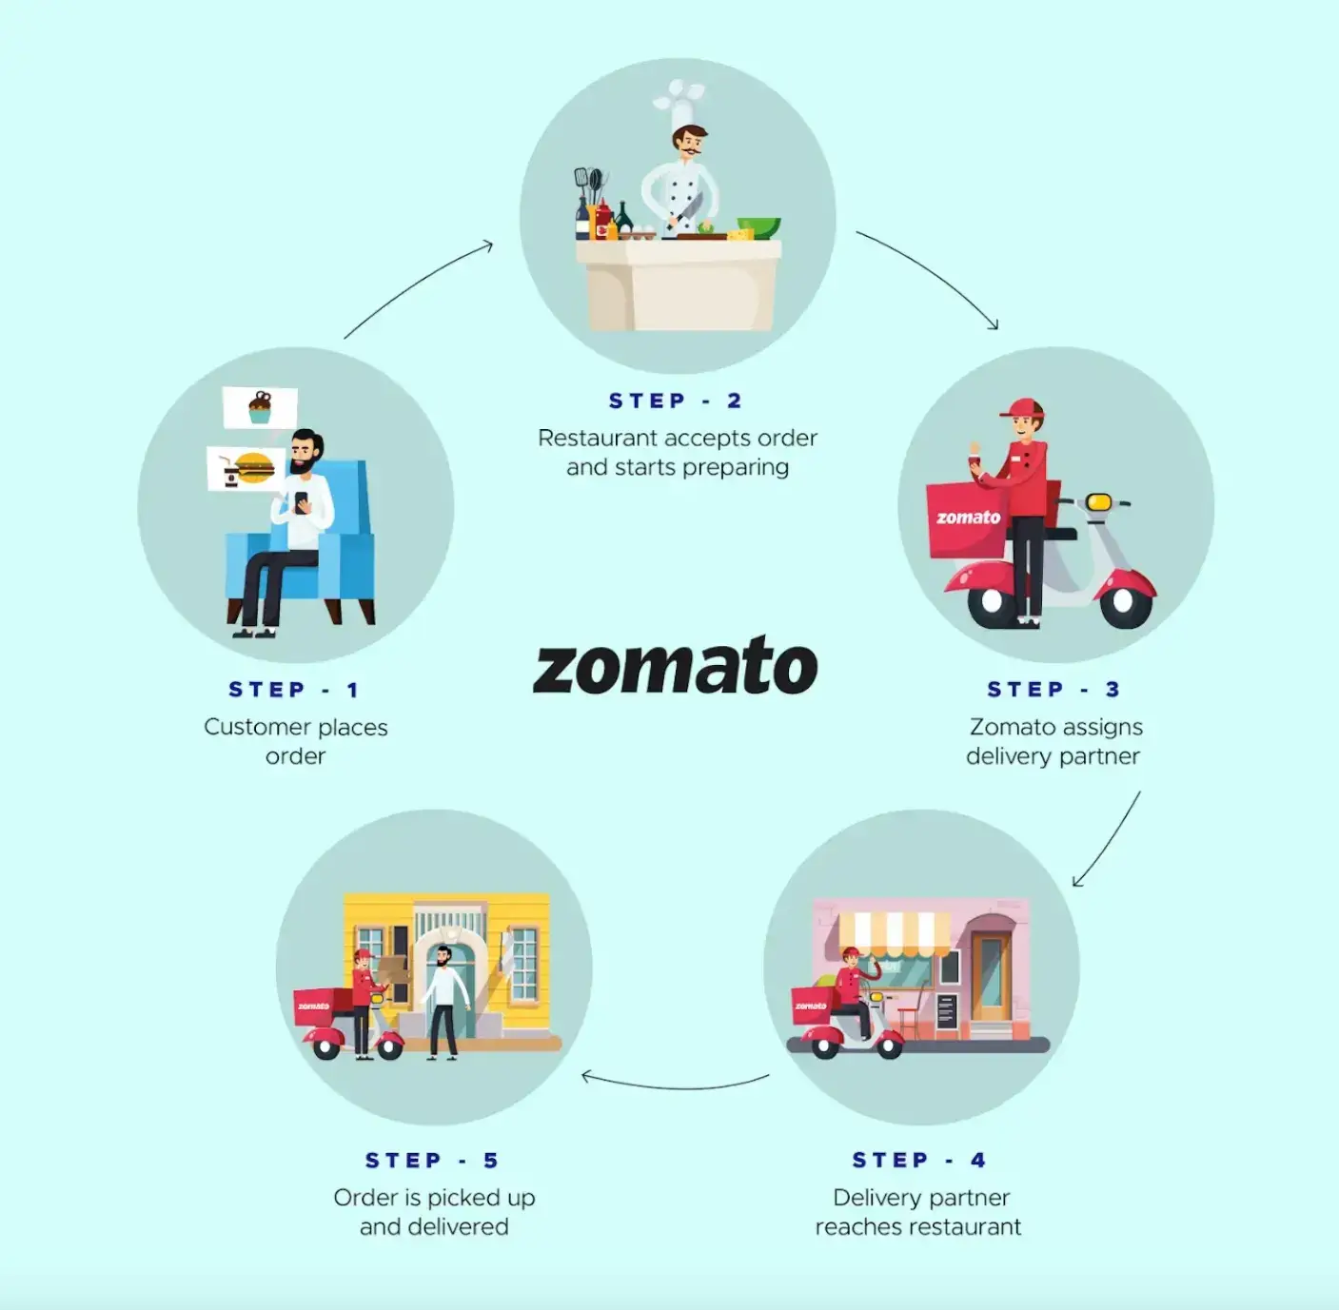
ZOMATO…..
An online restaurant directory and food delivery service that helps users find nearby restaurants, order food,and get it delivered
Started in July 2008 by Deepinder Goyal & Pankaj Chaddah
Initally named as “Foodiebay”
Renamed as “Zomato” in November 2010

Slide 3

Zomato team is looking for expansion and opening restaurants. Your task is to come up with strategies/suggestions about opening newer restaurants.
PROBLEM STATEMENT…..

Slide 4
Analyzing zomato data set for expansion of restaurants

Slide 5
Zomato Marketplace Data Snapshot
Total restaurants-9551
Total countries – 15
Total cities – 141
( Indicates wordwide spread)
This dataset can help Zomato understand its restaurant partners, user preferences, and market trends, allowing the platform to improve its services and offerings.
Insights from user and restaurant demographics are key to decide expansion areas and biggest competitors in an area
Data preprocessing and cleaning
Addressed missing values in Cuisines,Average_cost_of_two to enhance data integrity
Added country names in data for better understanding and analysis
Retrieved currency symbol and unified them with average_cost_of_two
Normalized the date format

Slide 6
Analytical approach and tools
Data Cleaning- - Used Excel's data cleaning features like find correcting errors, and formatting data appropriately. - Used functions like CONCATENATE, FIND, MID) to manipulate and clean data if needed.
Descriptive Statistics: - Used functions like AVERAGE, COUNT, MAX, MIN, and SUM to calculate basic statistics
- Created pivot tables to summarize the data and analyze trends.
Data Cleaning- - Used Excel's data cleaning features like find correcting errors, and formatting data appropriately. - Used functions like CONCATENATE, FIND, MID) to manipulate and clean data if needed.
Visualization - - Created Excel charts (e.g., column,bar charts, pie charts, scatter plots) to visualize relationships between variables like restaurant count , ratings, average cost, and votes. - Created maps using geographical data (latitude and longitude) to visualize the distribution of restaurants
- Created dynamic dashboard for data representation , enabling interactive data exploration
Data Enrichment- - Enhanced the dataset with additional fields and values using Vlookup functions in Countryname,
Segmentation: - Applied sort and Filter functions to classify restaurant based on eating behaviour and demographics

Slide 7

Exploratory Data Analysis

Slide 8
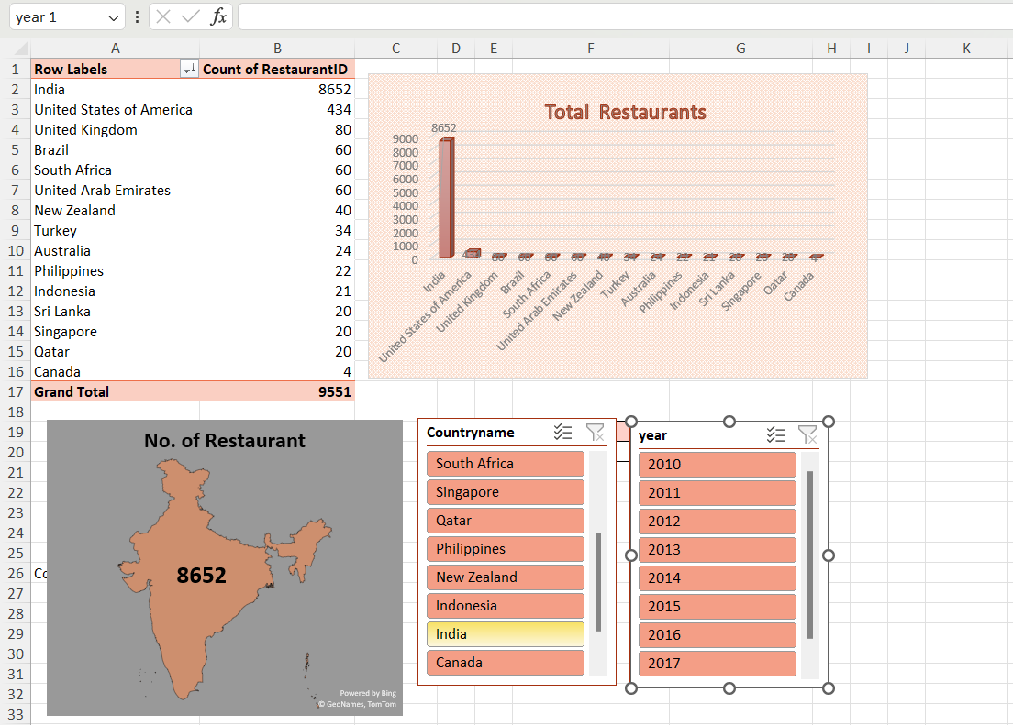
No of Restaurant across various countries & cities
This pivot table and visualization through Chart gives us an insight of the no. of restaurants in all countries and in their respective cities
It gives us an idea whether the market there is too clustered or less unexplored , helping us to decide where to focus more for expansion

Slide 9
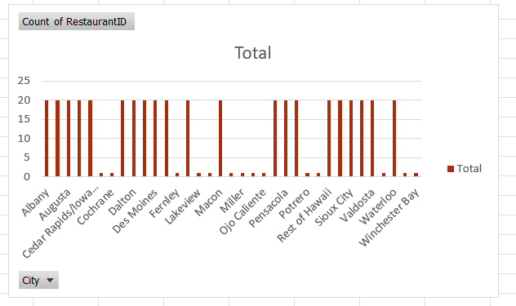
No of Restaurant across various countries & cities
Further more we can also get a better in depth count of each country/city with help of Year wise and country wise slicer

Slide 10
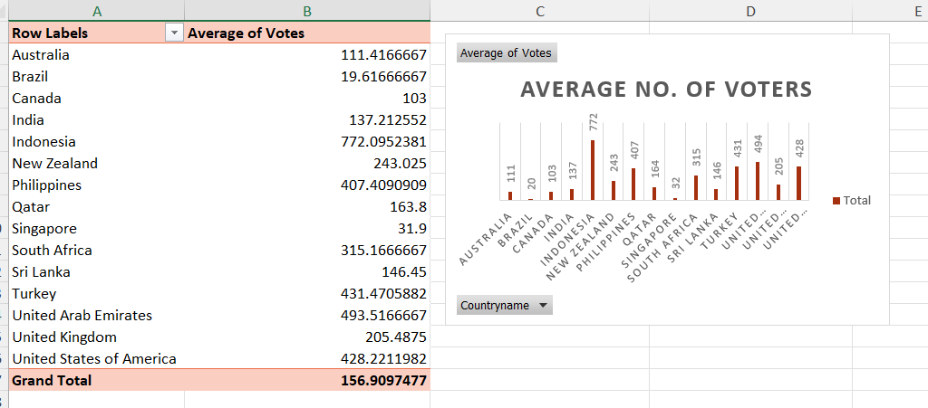
Countries with higher average votes gives an indication that their restaurants are more popular or attract more customers. This could be due to various factors such as the quality of food, service, and overall dining experience.
Higher average votes also suggests restaurants to be of higher quality, as customers are more likely to vote positively for restaurants they consider to be good.
Higher average votes suggest that consumers in those countries are more engaged with restaurants

Slide 11
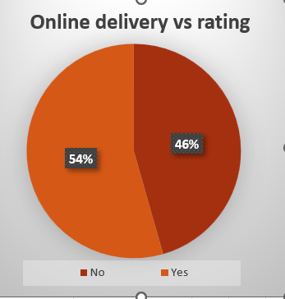
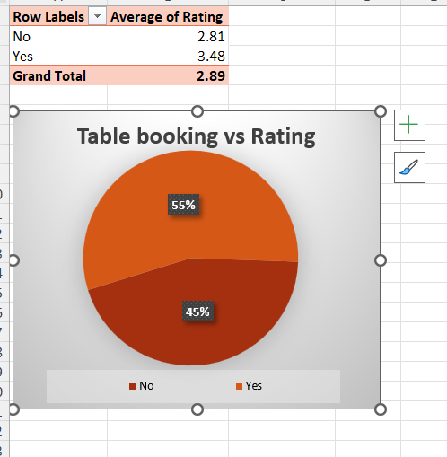
Higher ratings for restaurants with these options could suggest that customers value the convenience of ordering online or booking tables in advance.
Restaurants offering online delivery and table booking have higher ratings, indicating that these services contribute to customer satisfaction.

Slide 12
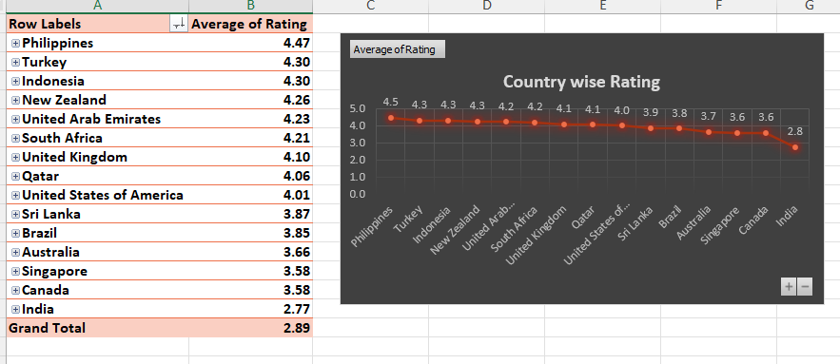
This graph gives us an insight about areas with good Average rating of restaurants
Higher ratings of restaurant in a country suggests that restaurants are performing good which is ideal for Zomato to tie up with
Countries with higher average ratings may represent markets with high potential for expansion, as there is already a positive reception to dining experiences.

Slide 13
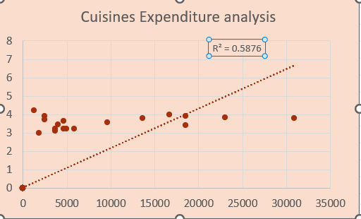
Comparing the average rating with the price of two help in understanding customer perceptions, market dynamics, and the competitive landscape
Here , average price of cuisine and the rating are weakly correlated, with a value of 0.5876
It may not be advisable for the team to solely focus on keeping higher rates of cuisines to get better ratings.

Slide 14
Recommendations
Expansion areas -
In areas with less no. of restaurant which suggest chances of less competition
In areas with average rating>=3.5 which suggests good quality service and receptive audience.
In areas with Lower price range (1-2) which means more affordable foor customers , hence engaging more customers
Also to expand in areas considering vote count(>150) indicating a receptive customer base
Online delivery and Provide Table booking-
We should consider expanding these services to improve customer satisfaction and ratings.

Slide 15
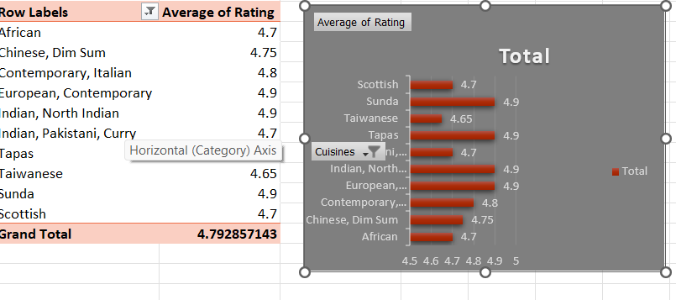
Recommendations
Cuisine choice-
we should include the popular cuisines (higher rating) in menu popular to improve ratings

Slide 16
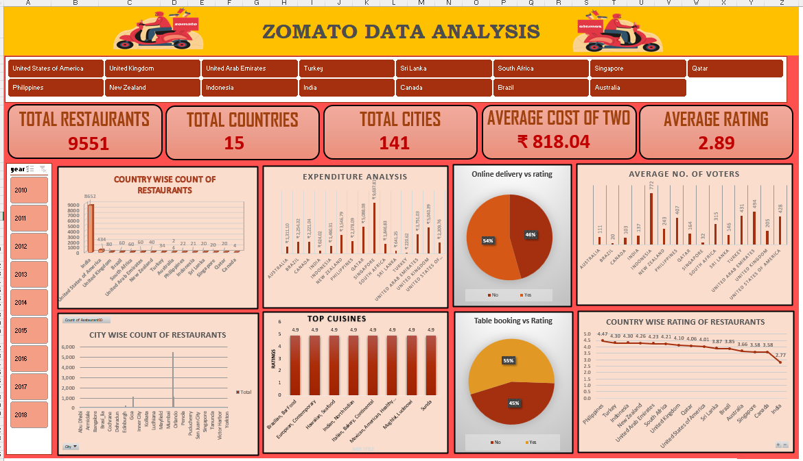

Slide 17
Understanding of Dashboard
Column Chart - Count of Restaurants Country-wise and City-wise:
This chart provides a visual representation of the number of restaurants in each country and city.
It helps in understanding the distribution of restaurants across different regions.
Pie Charts - Table Booking with Rating and Online Delivery with Rating:
These pie charts compare the percentage of restaurants offering table booking and online delivery, respectively, in relation to their ratings.
They help in understanding the correlation between these services and customer ratings.
Country Slicer:
Allows users to filter the data by country, enabling a more detailed analysis of restaurant data for specific countries.
Year Slicer:
Allows users to filter the data by year, if applicable, enabling analysis of trends over time.
Bar Chart - Top 10 Cuisines of a Country and Their Ratings:
This chart compares the ratings of the top 10 cuisines in a selected country.
It provides insights into the popularity and quality perception of different cuisines.
Column Chart - Country-wise Average Rating of Restaurants:
This chart displays the average rating of restaurants in each country.
It helps in identifying countries with higher-rated restaurants.

Slide 18
Country and city for Expansion
So , Acc. To my analysis and Criteria
Zomato can expand and open new restaurant in these countries and cities as they offer more chance of success and growth .

Slide 19
https://www.youtube.com/watch?v=bG1Qha-Ii7A&list=PLmejDGrsgFyDN-HoP5wlkvq9zKbWM9KtT https://youtu.be/gTK5rNhWJyA?si=kNijSyT-xUIt4w25 https://images.app.goo.gl/geeGKqsPad5AmDP37
References

